Slide 1
Key Concepts!
Understanding these will be helpful!

Slide 2
Here’s what we’re covering
AWS/Cloud Technology
Static Website Hosting
Infrastructure as Code
Lambda
Event-Driven Architecture
Serverless Framework

Slide 3
AWS / Cloud Technology

Slide 4
Instead of companies spending loads on setting up, running and maintaining their own hardware/data centers to host their application, databases etc – they can ‘rent’ the required resources from cloud providers.
Economies of scale mean cloud providers can ‘rent’ out these resources at a competitive price.
As long as you’re managing your resources correctly, this can save companies a lot of money!
Cloud technology has democratized the use of really expensive hardware!

Slide 5
“A static web page is a web page that is delivered to the user exactly as stored, in contrast to dynamic web pages which are generated by a web application.”
Thanks Wikipedia!

Slide 6
Infrastructure as Code
Version control your infrastructure
Examples: Storage, Servers, Databases, Permissions
Terra Form (Hashicorp), CloudFormation (AWS), Resource Manager Templates (Azure) and others…
Old world = manual, not consistent, no version control

Slide 7
Cloudformation in Yaml: s3 Bucket
AWSTemplateFormatVersion: 2010-09-09
Resources:
S3Bucket:
Type: AWS::S3::Bucket
Properties:
AccessControl: PublicRead
WebsiteConfiguration:
IndexDocument: index.html
DeletionPolicy: Retain
Bucket: !Ref S3Bucket
Outputs:
WebsiteURL:
Value: !GetAtt
- S3Bucket
- WebsiteURL
Description: URL for website hosted on S3

Slide 8
Lambda
Scales on demand and you only pay for the service when it’s invoked.
Execute your function based on events
Event Notification
State/Data Change
Lambdas can run for maximum 15mins and can support 1000 concurrent invocations
Lambda functions can be written in Node.js, Java, Go and C# and Python
Lambda allows you to run code without worrying about the underlying infrastructure!
Lambda is an example of a serverless resource.

Slide 9
Event = User Clicks Link (API Gateway Event)
Function = Retrieve Requested Information

Slide 10
Event = Alexa Skill
Function = Update Calendar, Play Music, Look up Location

Slide 11
Event = Notification via SNS
Function = Slack API call to post a message

Slide 12
Event-driven architecture is a software architecture pattern promoting the production, detection, consumption of, and reaction to events.
Thanks Wikipedia!

Slide 13
Why/Why Not Event-Driven Architecture?
A way to decouple systems
Compliments Agile ways of working
Easier to model systems
Can get complicated

Slide 14
You can use infrastructure as code to deploy a serverless application and it’s supporting resources via the Command Line.
In the context of AWS, you can use the Serverless Framework to deploy a Lambda function and it’s associated resources.
Use cases include any functions you might use Lambda.
There’s loads of examples at https://serverless.com/examples/
“The Serverless Framework is an open-source CLI for building and deploying serverless applications.”
https://serverless.com/framework/

Slide 15
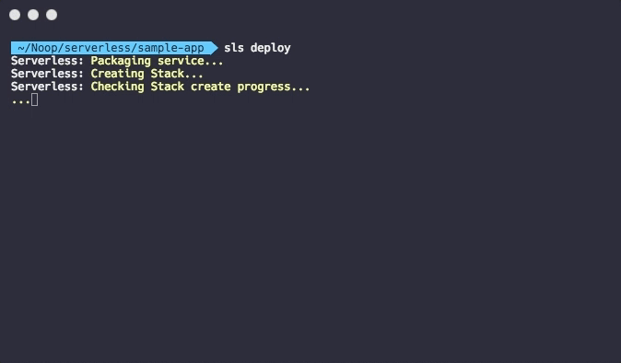
sls deploy

